Slide 1

Retail Competition:
To Be or Not To Be
Ken Malloy
Center for the Advancement of
Energy Markets

Slide 2
Overview
Introduce CAEM
Energy Restructuring 2001:
  Should we continue to restructure?
  Yes, But we have screwed it up royally
  Where do we go from here?

Slide 3
Center for the
Advancement of Energy Markets
Discovering consumer, business, and environmental advantage in energy markets transformed by technology and competition

Slide 4

Center for the
Advancement of Energy Markets
CAEM
  Three Years Ago
  Retail was destined for failure
  Something Missing
  Think Tank on Energy Restructuring
Character
  Independent
  Market-Oriented
  Non-Profit-501(c)(3)
  Change Agency, Think Tank
  Not a lobbying group, trade association, or consulting firm
Mission
  Define
  Discuss
  Build Consensus
  Advance
Canadian Affiliate
  October 2001

Slide 5
Board of Directors
AES
Automated Energy
Dynegy
Deloitte & Touche
Exelon
Green Mountain
Haddington Ventures
KeySpan
Madison Gas & Electric
Navigant
New Power
Primen
Williams
Larry Bickle, CEO
Cody Graves, CEO
Dennis Kelly, CEO
Gene Lockhart, CEO
Ernie Moniz, MIT
Bob Rowe, ex Pres. NARUC
Joel Singer, CEO
Branko Terzic

Slide 6
Contribution to Intellectual Capital
Retail Energy Deregulation Index (RED Index)
DISCO of the Future
Lessons Learned from Natural Gas Restructuring
Distributed Energy Task Force
Grid Enhancement Project
Canadian Energy Restructuring Forum
Pricing and Cost Allocation Task Force

Slide 7
Restructure What:
Competitive Network Policy
Traditional
Command-and-Control
Monopoly Utilities
Bundled Services
Cost-Plus Pricing
Silo-Based Products
Fragmented
Parochial
State Focused
Emerging
Market Based
Customer Choice
Unbundling/Access
Performance Based
Convergence
Consolidated
Regional/Global
Federal Focused

Slide 8
Been There, Done That
Case Study-Federal Gas Access
Phase I
Phase II
Phase III
Phase IV
Phase V
Congressional Action (NGPA in 1978)
Order 380
Open Access Blueprint (Order 436 )
Implementation and Refinement of Open Access
  Order 451
  Order 497
  Order 500
Ancillary Issues
  Wellhead Decontrol
  Order 636
    Rate Design
    Merchant Deregulation
    Secondary Market
    Transition Costs
INCOMPLETE 2001
Performance Based Regulation
Secondary Market for Capacity
Affiliate issues
Congressional Action (NGPA )
1978
1985
Mid 1980s
1989/1992
1998

Slide 9
Illustration of Access Path:
Increase in 3rd Party Access on Natural Gas Pipelines
% of 3rd party sales
100
90
order 497
1986
80
order 636
1992
70
60
order 436
1985
EPACT
1992
50
40
NGPA
1978
Capacity
PBR
Affiliates
2001
order 380
1983
decontrol legislation
1989
30
20
order 500
1988
10
0
1978
1980
1982
1984
1986
1988
1990
1992
1994
1996

Slide 10
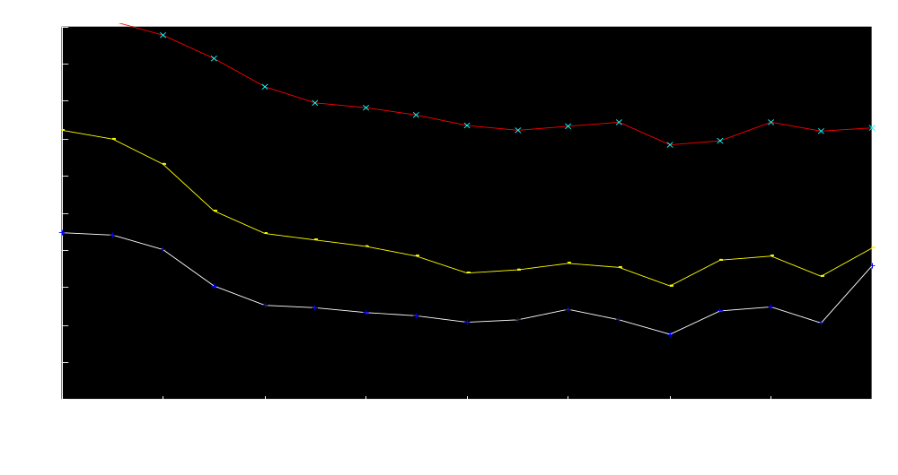
Natural Gas Prices
Gas Competition Benefited Residentials
1995$/mcf
New CAEM Study:
$6000 per Household
  % Reduction Since 1983 Residential - 31%
  Industrial - 44%
  Producer - 20%
Residential Price
Industrial Price
Wellhead Price
Source: Energy Information Administration

Slide 11
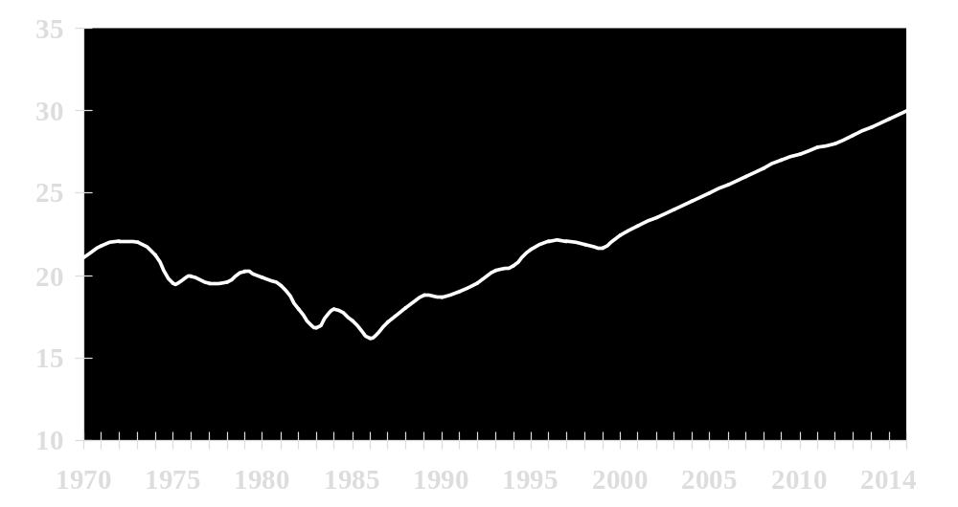
Natural Gas Consumption
Natural Gas was disfavored fuel in 1970s energy policy
Tcf
EIA Projection
Environment
Energy Security
Economic Gain
Access Policy
Source: Energy Information Administration

Slide 12
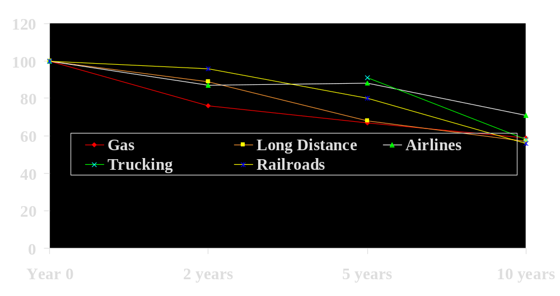
Industry Deregulation and Price
% real price reductions after
Source: Crandall and Ellig (1997)

Slide 13
2001: Despair and Disarray
Energy Restructuring is a Disaster
UFO Abductees better organized
Congressman Joe Barton
  California is the poster child for energy restructuring.
California, Enron, and prices have made issue of competition in energy front page news
No Coherent Model so a thousand flowers bloom
Raises significant question of whether competitive model will work for mass customers and whether adequate supplies will be developed

Slide 14
Why are we having problems?
Retail Access will be more complex
FEDERAL STATE
One Customer Class  Multiple Classes
◆ Less Political  More Political
◆ One Energy Form  Multitasking Reform
◆ Limited Issues  Multidimensional
◆ FERC  64 PST’s
◆ 25ish Companies  250 to 4000 corps
◆ FERC Funded  States Underfunded
◆ Control  Coordination
◆ 15 year transition  Even longer transition

Slide 15
How do we measure progress?
Indices—Simplify Complex Situations
  Thermometer of 104
  DOW over 11,000 or Price to Earnings Ration of 25
  CPI at 3.5%
  Federal Reserve Price Cuts of .5%
  Hurricane Mitch was a Category 5 on Saffir-Simpson Hurricane Intensity Scale.
RED=Retail Energy Deregulation
  22 Key Issues that Determine the Quality of Access
  Scale from 0 to 100—Negative Numbers Possible
  Survey of State Commissions
  Updated 2x a year
Comprehensive New Methodology
  Coverage extended to Canada and Australia and to Gas this year
Introduce Nat Treadway, Project Director of the RED Index

Slide 16
22 Key Attributes in 5 Clusters
A. Framework Cluster
plan, eligible customers, switching customers, competitive safeguards, standardization, billing competition, metering competition
B. Generation Cluster
market structure, wholesale market, stranded cost standard, stranded cost implementation
C. Consumer Cluster
information, education, default provider
D. Distribution Cluster
price risk, default rates, performance based regulation, network pricing, and distributed resources
E. Commission Cluster
regulatory convergence, reengineering, budget

Slide 17
Texas tied for first
Even before debacle, California barely in top 20
Province, State or Territory | 2002 Score | 2002 Rank
Texas | 68 | 1
Pennsylvania | 68 | 2
Maine | 65 | 3
New York | 56 | 4
Maryland | 50 | 5
DC | 49 | 6
New Jersey | 49 | 7
Victoria, Australia | 45 | 8
Alberta, Canada | 45 | 8
Michigan | 45 | 8
California | 5 | 28

Slide 18
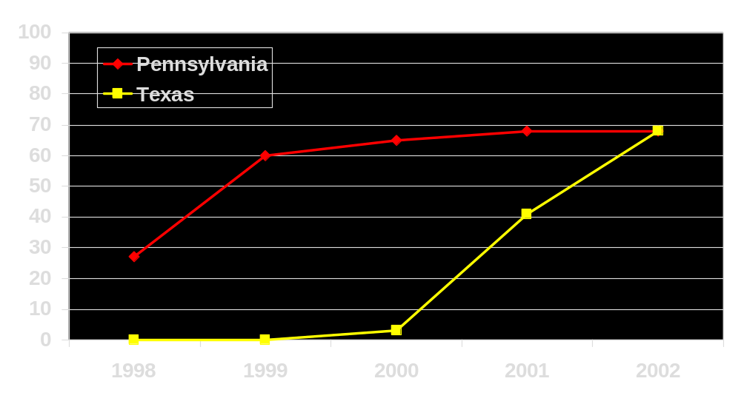
Texas vs. Pennsylvania Path

Slide 19
Texas: We’re Number 1!
Attribute | 2002 Characterization | Highest Possible Score | 2002 Score
1. Plan | Detail | 5 | 5
2. % Eligible | 70% | 5 | 5
3. % Load Switched | 2% | 5 | .5
4. Safeguards | Corporate | 10 | 7
5. UBP | Consensus | 10 | 10
6. Billing | Consolidated | 3 | 3
7. Metering | Delayed | 2 | 1
8. Generation | Incentives | 10 | 7
9. Wholesale | Bilateral | 5 | 5
10. SC Calculation | Not an Issue | 3 | 3
11. SC Implementation | Not an Issue | 3 | 3
12. Customer Information | Excellent | 2 | 2
13. Consumer Education | Understanding | 2 | 2
14. Default Service | Experiment | 15 | 4.5
15. Price Risk | Fixed | 4 | 2
16. Rates | Rationalization | 4 | 2
17. PBR | No Action | 2 | 0
18. Network Pricing | Cost of Service | 2 | 0
19. DG Interconnection | Aggressive | 5 | 5
20. Convergence | No Action | 1 | 0
21. Reengineering | Some | 1 | .5
22. Budget | Level | 1 | 0
RED Index Score US Rank North American Rank |  |  | 68
 |  |  | 1
 |  |  | 1
But it is a pretty stupid class.

Slide 20
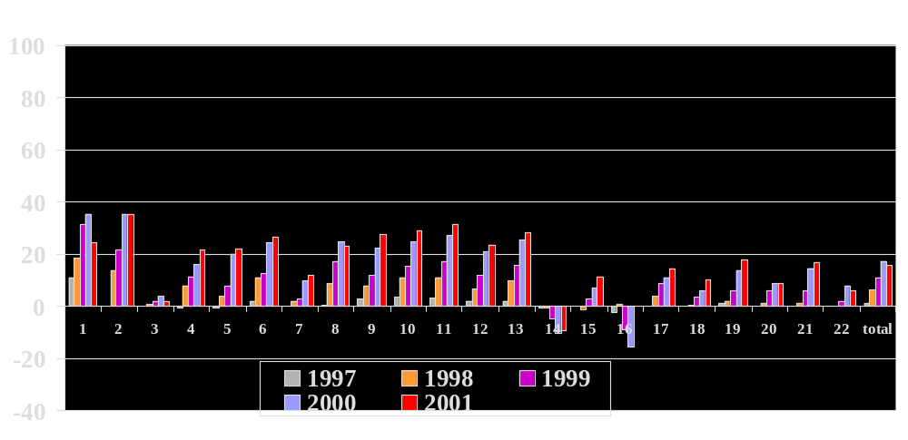
Progress on Accomplishing Attributes

Slide 21
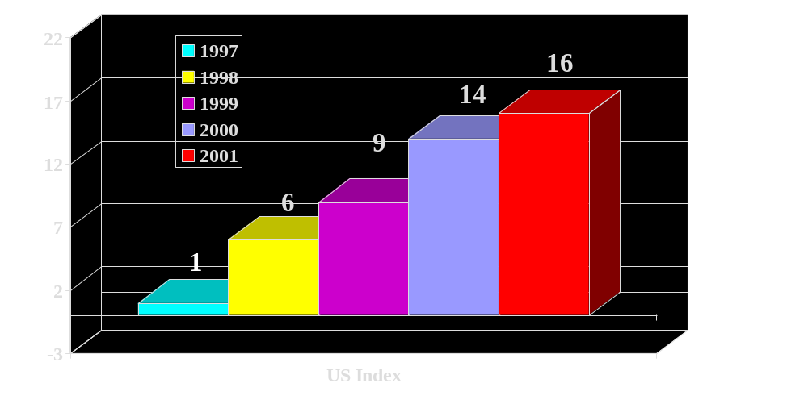
US National Red Index Score

Slide 22
Success of RED Index
PA Governor used it in State of State Address
NY PSC and Texas issued Press Releases
Vermont DPS uses it as strawman
Alabama Attorney General
World Bank: “most sophisticated scorecard for measuring power sector reform.”
Full Page in USA Today
Provided free to 1600 public sector organizations

Slide 23
Homework Assignment
Xenergy’s Retail Energy Markets Report and Retail Energy Foresight won the RED Letters Award Last Year
FTC Report for Congressman Tauzin on Retail Competition will win this year’s RED Letter Award
Skipping Stone’s Report on the Texas Market

Slide 24
Action: Process
Movement is in disarray
  Who is the acknowledged leader who inspires and challenges?
  Where is the battle plan for winning this war?
  Where can we go to meet fellow travelers to gain comfort from the wearying battle?
  Where do I go for training in the new paradigm?
  Where is an organization of the broad and diverse elements of the movement ?
Einstein’s Definition of Insanity
  Doing the same thing over and over expecting a different result.

Slide 25
Action: Strategy
Einstein writes to Roosevelt in 1939: Germans building an atomic bomb
Six years later US ends World War II by dropping Little Boy and Fat Man on Japan.
Manhattan Project represented “the greatest single achievement of organized human effort in history.”
Vision, courage, leadership, and commitment in the face of gargantuan obstacles.
Where is anything approaching that in the energy restructuring movement.
We need a Manhattan Project for energy restructuring!

Slide 26
Action: Organization and Intellectual Capital
Organization and leadership is not evident in the industry today
  We recently established the Friends of Restructuring and the Leadership Council on Energy Competition to begin to meet this challenge
Intellectual Capital—unbiased understanding of problems and solutions—is in short supply
  We recently established the IDEAS Foundation to begin to meet this need
  Integrated Development of Essential Assets and Services

